Slide 1

The ESP Program at National Cheng Kung University (NCKU)
Wenli Tsou, Professor
National Cheng Kung University
鄒文莉
國立成功大學外國語文學系教授
2013/04/14

Slide 2

Outline
The NCKU ESP program
Needs Analysis
Material designs
Assessment aims and indicators
challenges of ESP implementation

Slide 3


Driving Force 1
In 2005, the Ministry of Education in Taiwan published a set of implementation guidelines for the years 2005-2008 (教育施政主軸行動方案), in which universities and colleges are to upgrade students’ English skills by requiring them to pass proficiency tests before graduation.

Slide 4
NCKU English Requirement for Graduation
Regular Standard (B2):
The General English Proficiency Test (GEPT):
High-Intermediate listening and reading
TOEIC:750
TOEFL IBT: 69
IELT: 5.5
High Standard (C1):
GEPT: High-intermediate speaking and writing
TOEIC: 820
TOEFL IBT: 79
IELT: 6.5

Slide 5
Driving Force 2
As an extension to the MOE mandate, the NCKU Policy informs students that English learning is more than about acquiring a second language; the English education on campus should be seen as preparing students for global citizenship.
The goal of English education more than about passing a proficiency test; it’s about developing language skills needed for classroom and career.

Slide 6
NCKU ESP Program
NCKU ESP program was established in 2007 to revamp the existing sophomore English curricula.
  Freshman English courses integrate academic words to bridge its EGP design to ESP
  Sophomore English re-oriented toward students’ specific academic studies so that the language education is linked with mainstream courses

Slide 7
Needs Analysis
In 2007, a needs analysis was conducted and involved approximately 1,000 students and 30 professors from different fields.
The data indicate that students and their professors identified different needs.
While professors believed reading to be the most important skill for the university’s sophomore students, students themselves considered speaking skills as most needed.

Slide 8
Needs Analysis
Subject professors expressed different opinions regarding what type and how much content knowledge to include in EAP courses.
As a result, it was decided that 30% of the materials contains content knowledge whereas 70% is related to language.
  Developing reading skills and provide oral training would allow students to perform tasks in mainstream courses and in the workplace.

Slide 9
Curriculum Designs
Curriculum goals
  Developing reading skills
  Acquiring discipline specific and general vocabulary
  Learning to perform speaking-related academic and professional tasks
Textbook design
  Content: 70% English learning, 30% disciplinary content knowledge
  Authentic materials: professional publications, government statistics, case studies
  Authentic tasks: presentation, group discussion, role play for professional & academic contexts
  Corpus application to vocabulary learning
Learner assessment
  Achievement tests (vocabulary, reading comprehension, speaking tasks)
  Proficiency (TOEIC)

Slide 10
Material Designs
During materials compilation, at least one ELT supervisor was assigned for each textbook. They supervised the materials development process and attended the biweekly meetings.
Subject professors provided consultation before and during the planning and compilation processes. They also reviewed materials after the lessons were developed. These specialists ensured that appropriate content, skills, tasks were included.

Slide 11
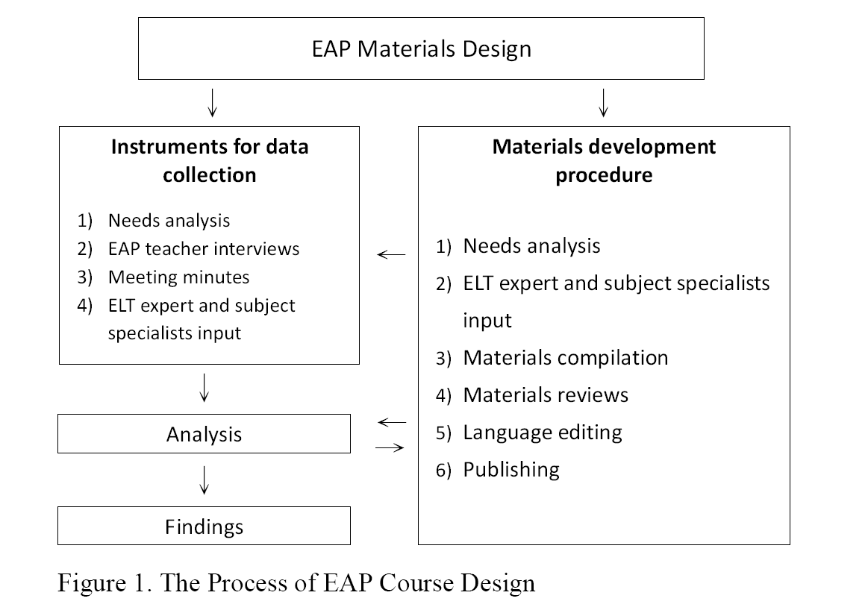
The Process of Course Designs

Slide 12
Learning Assessments
Achievement tests
  Scope: advanced ESP content and skills
  Item and skills:
    ESP vocabulary (quizzes) 10%
    Reading comprehension (midterm) 25%
    Speaking skills (final) 25%
  60% testing aligned across disciplines
Proficiency tests
  Testing of general workplace English proficiency (TOEIC)

Slide 13
Implementation to Date
Introduced in 2010, 11 ESP project teachers
12 ESP courses, 55 classes, more than 3000 students
Content-based courses | Skill-based courses
English for Business Management English for Economics English for Basic Sciences English for General Engineering English for Information Technology English for Hi-tech Industries English for Biotechnology English for Health and Medical Care | English for Business Communication English for Tourism and Hospitality English for Careers English for Creative Industries

Slide 14
The Process of Course Designs
The uniqueness of this project lies in its response to learner needs and the cooperation among EAP teachers, ELT professors, and specialist professors.
While the textbooks designed in this project are far from being the perfect texts for immediate adoption, the study does demonstrate how EAP materials can be incorporated in research findings and how the development process can include subject professors

Slide 15
Program Evaluation

Slide 16
Aims of ESP Evaluation
Evaluate course materials and delivery
Assess learning results
Empower ESP teachers through participation

Slide 17
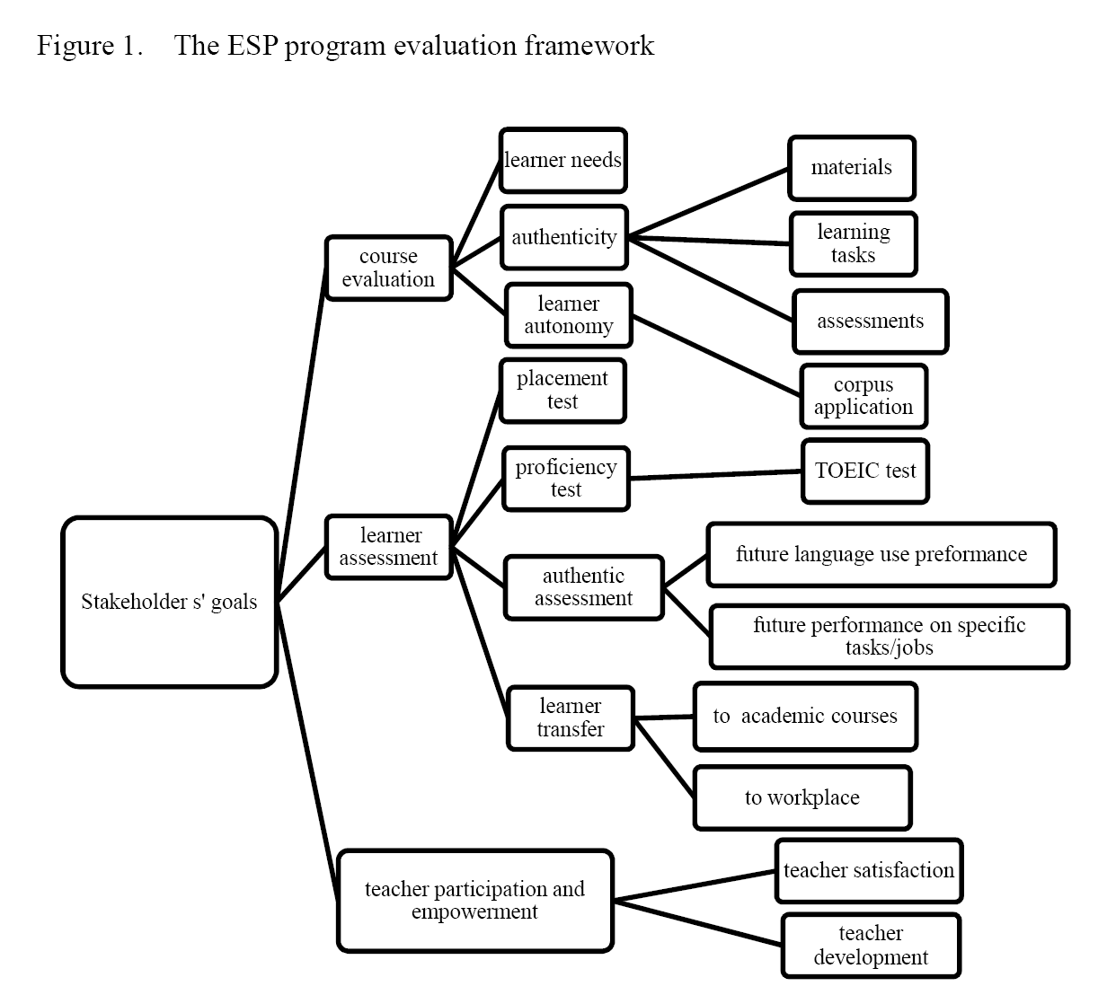
Evaluation Indicators

Slide 18
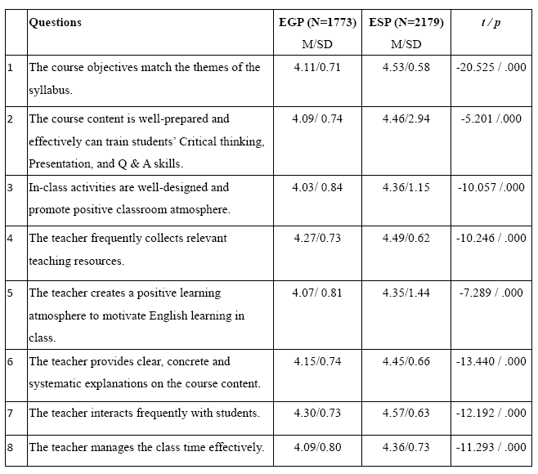

Slide 19
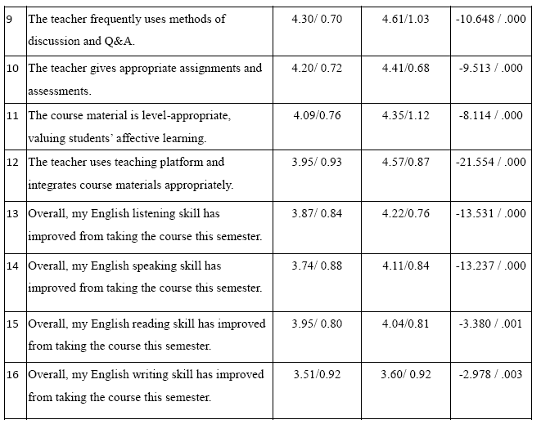

Slide 20
Achievement Surveys
 | Not improved | Don’t know | Somewhat improved | Improved | Greatly improved | Improved total
Reading | 3.8% | 2.4% | 45.8% | 43.7% | 4.4% | 93.9%
Vocabulary | 3.6% | 2.0% | 49.9% | 39.6% | 4.9% | 94.4%
Speaking | 7.3% | 3.6% | 46.4% | 35.9% | 6.9% | 89.1%
Presentation | 4.4% | 3.0% | 39.2% | 41.4% | 12.0% | 92.6%
Listening | 8.1% | 3.5% | 42.2% | 39.4% | 6.9% | 88.4%

Slide 21
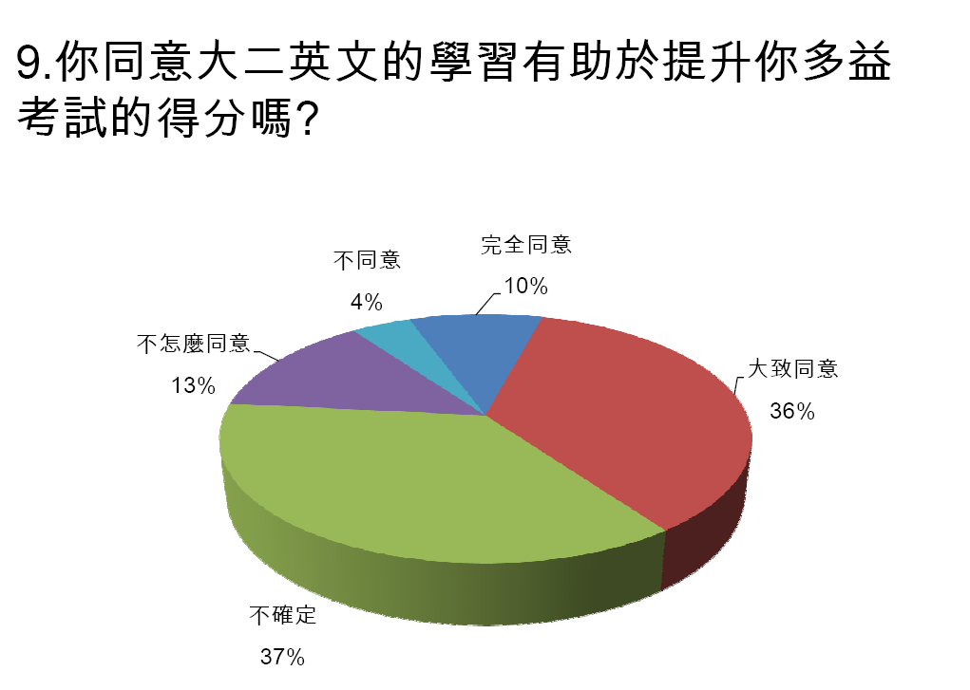
TOEIC results

Slide 22
TOEIC
(ESP=630, EGP=492) | Pre test | Post Test | Difference
Listening ESP EGP | 320 329 | 348 315 | 28 -13.8
Reading ESP EGP | 275 274 | 282 276 | 7 2.5
Total ESP EGP | 595 604 | 630 591 | 35 -11.3

Slide 23
Interpretations of TOEIC
  Improvement in listening suggests successful acquisition in classroom listening skills
NSKU ESP Listening | TOEIC Listening
In-class question/answer | Question/answer: Information “6W1H” and YES-NO types
In-class discussion | Short conversations
Classroom lectures | Short talks: advertisement, weather reports, announcements, etc

Slide 24
Interpretations of TOEIC
  Lack of improvement in reading may reveal difference in ESP and TOEIC texts
NSKU ESP Reading | TOEIC Reading
Content based articles related to various academic disciplines | passages in the form of letters, ads, memos, faxes, schedules, etc

Slide 25
Example 1: Memo
Example 1: Memo
Memorandum To: Supervisors From: Judy Linquiest, Human Resource Manager Sub: Probation periods As of January 1st all new employees will be subject to a 3 month probationary period. Medical, holiday, and flextime benefits will not apply to new staff members until the full 3 months have expired. After the three months have been completed, please contact your employees and inform them that their probationary period has ended. The HR department will contact you by email 2 days in advance to remind you of the date. Thank you for your cooperation.

Slide 26
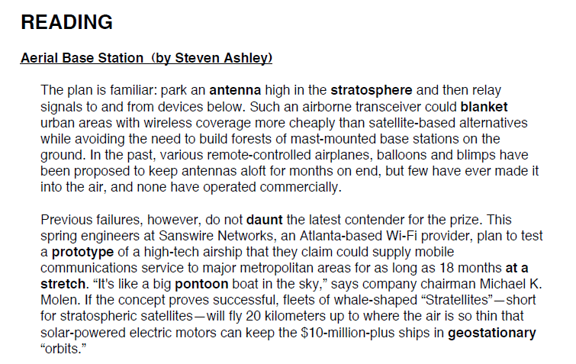
Excerpt from English for General Engineering (Unit 1, Lesson 3)
Original article posted in Scientific American, April 2005

Slide 27
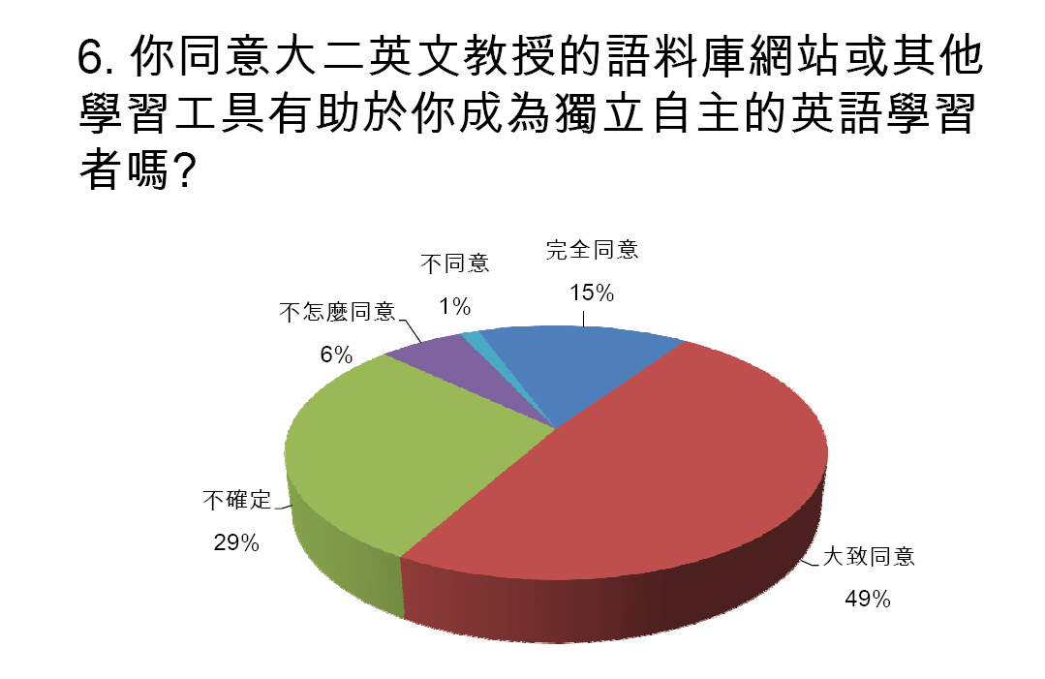
Learner Autonomy Survey
A survey was conducted at the end of the ESP implementation from 1193 students.
Nearly 64% of students agree that the ESP training help them to become independent language learners.

Slide 28
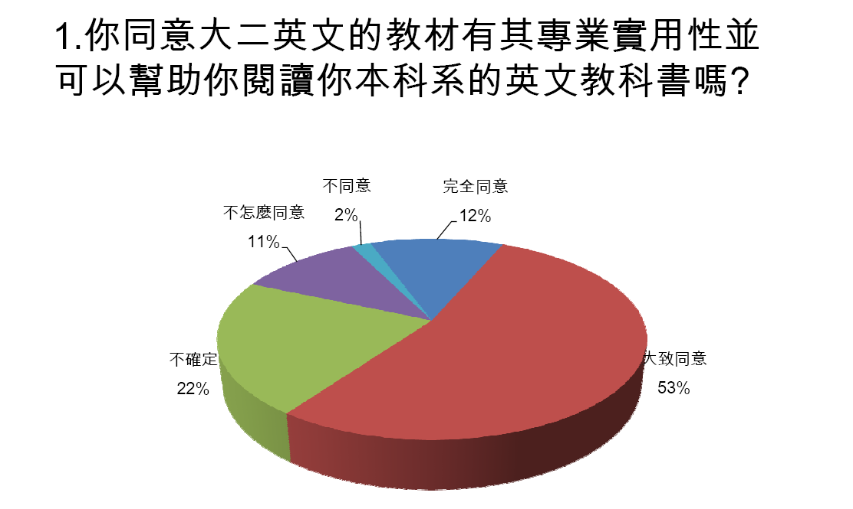
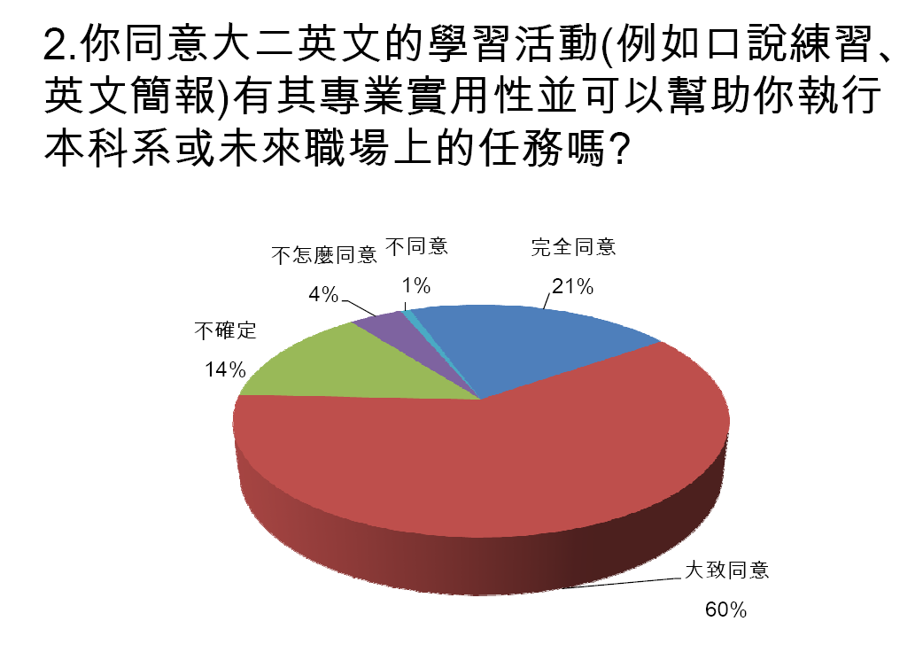
Learning Transfer Survey

Slide 29
Strengths of NCKU ESP Evaluation
Combines general proficiency and specific achievement tests (ESP ability indicators)
Considers qualitative indicators such as learner autonomy and learning transfer
Emphasizes positive outcomes such as ESP teacher participation and empowerment

Slide 30
成大各學院之英語能力指標 (English Ability Indicators)
 | 商管專業 | 科學及工程專業 | 生物科技及醫學專業
聽力 | 理解商業或經濟課程相關英語課程內容 理解顧客之需求及問題 | 理解科學或工程相關英語課程內容 理解指示並完成專業任務之執行 | 能聽懂專業課堂英語授課內容
口語 | 解釋商管或經濟概念並舉例說明 描述商業圖表並說明 提案建議 | 解釋科學理論或其應用並舉例說明 描述圖表並說明 給一系列之說明指令或步驟 | 能說明數據 報告學習心得 進行(Q&A)討論
閱讀 | 理解商業課文及相關出版品的主要概念 | 理解科學及工程課本及其相關專業領域出版品的主要概念 | 理解生醫課本及其相關專業領域出版品的主要概
寫作 | 敘述一個商業概念並舉例 敘述圖表 彙整提案大綱 | 敘述一個理論或應用並舉例 敘述圖表 寫出指引步驟 | 根據病例或實驗報告，使用英語重新描述病情或過程

Slide 31
Challenges for ESP Implementation
Affecting authenticity
  choices between wide and narrow angle curriculum affecting authenticity
Affecting effectiveness
  Limited time available for authentic tasks
  Limited time and equipment for learner autonomy training
  Difference between target and actual students registered for each class

Slide 32
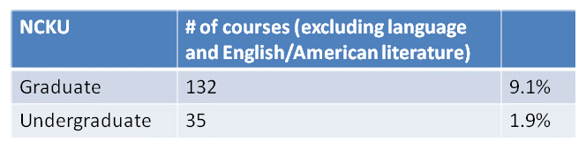
Limitations
Learning transfer difficult to assess because few undergraduate English mediated courses are available (not included language related courses)

Slide 33
Limitations
Learning transfer difficult to measure because of the time gap between sophomore English and when learners use English for work
Proposal: The University to continue English education beyond Sophomore English. These courses will focus on specific disciplinary contexts and different language levels.

Slide 34
Thank you! wtsou@mail.ncku.edu.tw

